Slide 1


SCM Cloud Extensions using JCS-SX

Slide 2
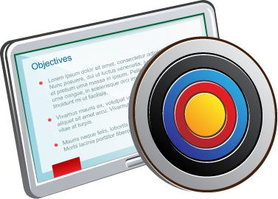
Lesson Objectives
After completing this lesson, you should be able to:
Understand how SCM cloud can be customized
Features of JCS-SX
How JCS-SX can be used for SCM cloud extensions

Slide 3

Java Cloud Service – SaaS ExtensionS
Key Features
Full-Featured: WebLogic 12c or 11g Instance
Clustering, In-Memory, High Availability, Elastic Load Balancing, Scale Up & Scale Out
Oracle Back Up/Restore, Patching, Application Server Management
Full portability: On-premise to Cloud
Runs any Java application in the cloud
Complete Java EE Support
SOAP & RESTful Web Services
Eclipse, NetBeans, & JDeveloper Tools
Auto-generate Database Schemas
Differentiators
WebLogic/Java with RAC integration & In-Memory (Coherence)
Secure, Highly Available with Clustering
Rapid and fully automated provisioning
Fully Managed

Slide 4
Oracle JCS-SX Features
Oracle Java Cloud Service - SaaS Extension provides an enterprise grade platform to develop and deploy business extension for application services offered as Oracle Software as a Service, such as Oracle Sales Cloud, Oracle Service Cloud, etc.. Schedule Service: Provides methods for executing scheduler tasks, such as to schedule report jobs, retrieve report outputs, and manage report history.
Invoking Application Services Java Cloud Service: SaaS Extension natively understands the services exposed by Application Service. These can be standard Web Services, RESTful services, or direct interaction.
Embedding UI Flows in Application Services: Building web pages using Java or Oracle Application Development Framework and deploying them to Java Cloud Services is easy. But equally easy is to embed these pages in SaaS Applications to extend the functionality your business needs
Security: Every application deployed on the platform runs in completed isolated environment, with no sharing of application space or data. No other tenant can impact the performance and security of your business application extension. Extension Platform comes with dedicated identity domain to store application users and control their access, all with easy-to-use self-service identity management tooling
Marketplace: Businesses can benefit from the large number of extensions pre-built by Oracle partners. Oracle Cloud Marketplace is a market for business to look for available extension and easily deploy them in their extension environment.

Slide 5
Fusion SCM Extension process Flow
JDEVELOPER:
Develop ADF
Create ANT build files
Developer Cloud:
Create a Project
Cloud ERP
Create and activate a new Sandbox
Push the code to GIT
Push the code to GIT
Create a GIT REPO
Create a Build job to make EAR
Create a Deploy Job to deploy the EAR to JCS-SX
JAVA Cloud Service:
Check the Deployed ADF page and deploy Job Status
Create an Integration page
Publish the page

Slide 6
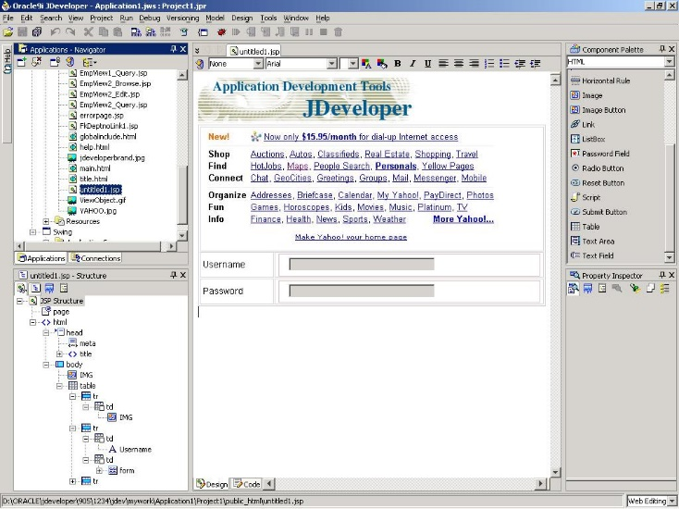
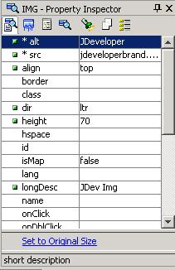
ADF Introduction
Visual and Declarative Development
Visual
WYSIWYG editors
UML modelers
Structure pane
Declarative
Structure pane
Property Inspector
Code view/design view synchronization
No separate generation step—always synchronized
Underlying code always accessible

Slide 7



ADF Intro (Contd)
MVC Structure
Controller
Handles routing to the correct page
Maps UI data changes to the Model
Display
Data and transactions
Submit page
View
Model
Renders the UI
Requests data from the Model
Sends “Events” to the Model
Allows the Controller to select the next View
Stores the application state
Responds to data requests
Encapsulates business logic
Request data
Notes:
What Is the Model?
It is a wrapper and abstraction for business services:
Handles data events from the Controller
Feeds data to the View
It manages and presents data from different Business Service types in a common way.
What Is the View?
The MVC View is the UI of the application.
It is what the end user sees and interacts with

Slide 8
ADF Technology Stack
JSP
ADF UIX
JSF
Swing/
ADF JClient
View
Struts
Controller
ADF Model
Model
Business Services
ADF Business Components
EJB Session Beans
Web Services
JavaBeans/ Other

Slide 9
ADF Summary
Productive end-to-end development
Model-View-Controller
Visual
Declarative
Standard J2EE framework
Implements J2EE best practices
Uses the latest standards
Provides architecture choices
Is built on the MVC design pattern

Slide 10
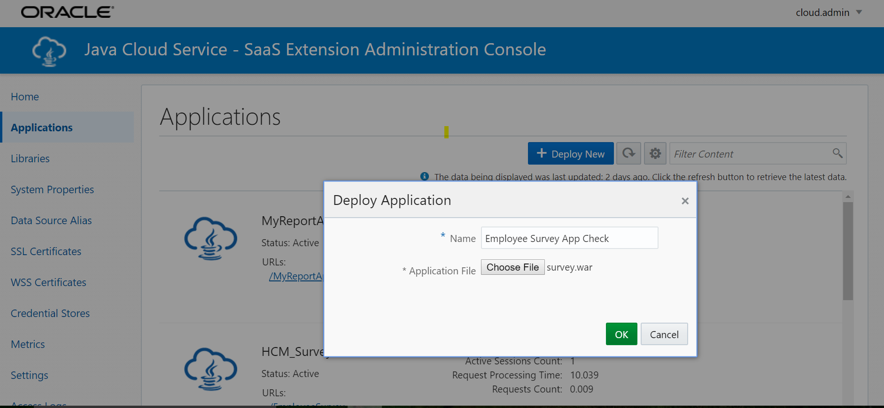
Deploying an application to JCS
Login to JCS-SX Click on Applications Click on deploy NEW Select WAR/EAR file and click OK

Slide 11
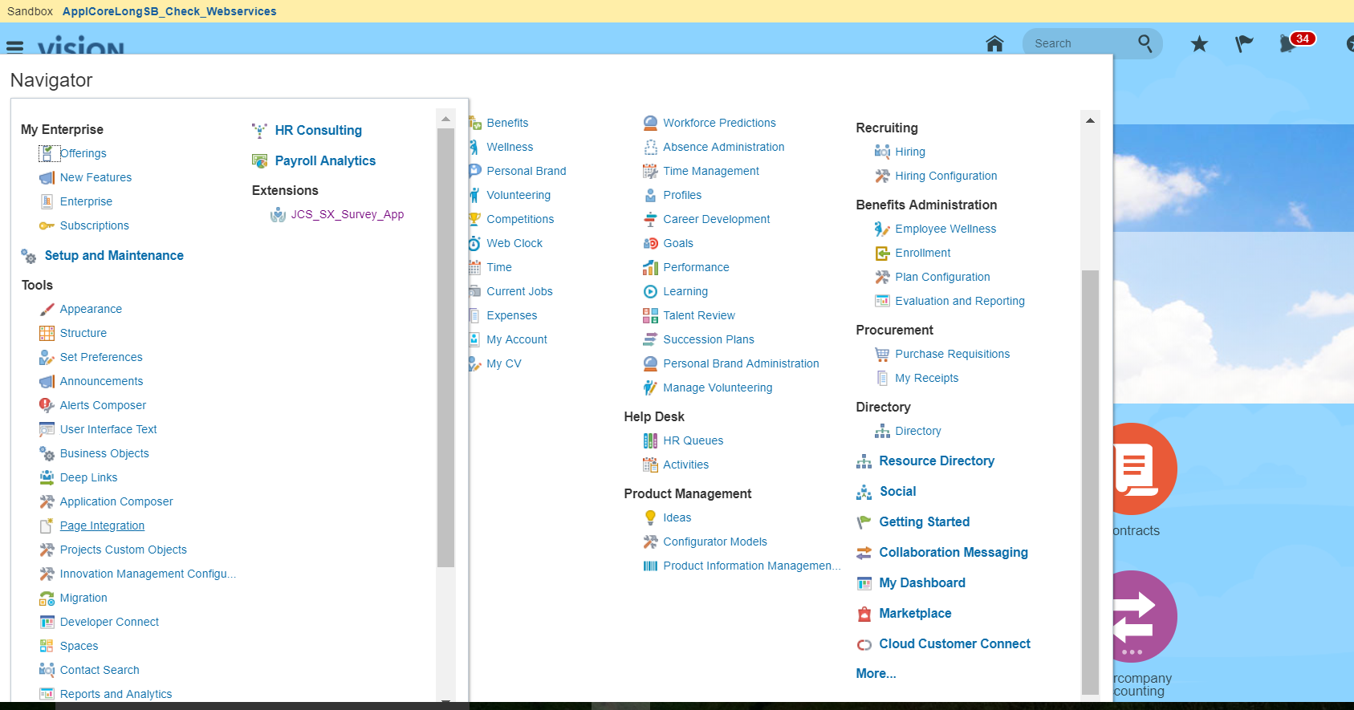
Creating Page Integrtion
Login to SCM Click on Navigator Select Page integration Enter end point URL of the Webpage deployed in JCS-SX

Slide 12
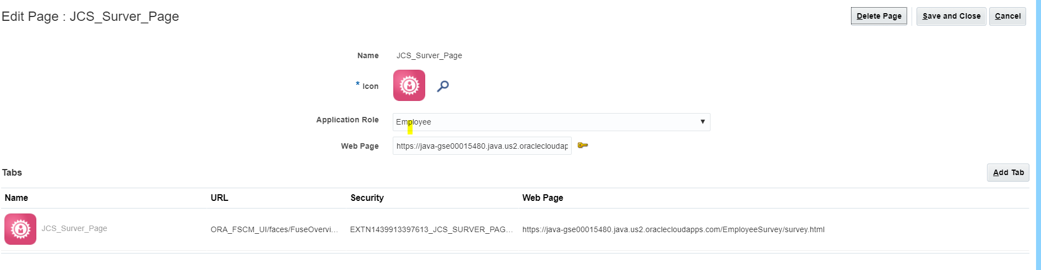
Creating Page Integration
Login to SCM Click on Navigator Select Page integration Enter end point URL of the web page deployed in JCS and enter other details
Notes:
The page can be accessed from

Slide 13
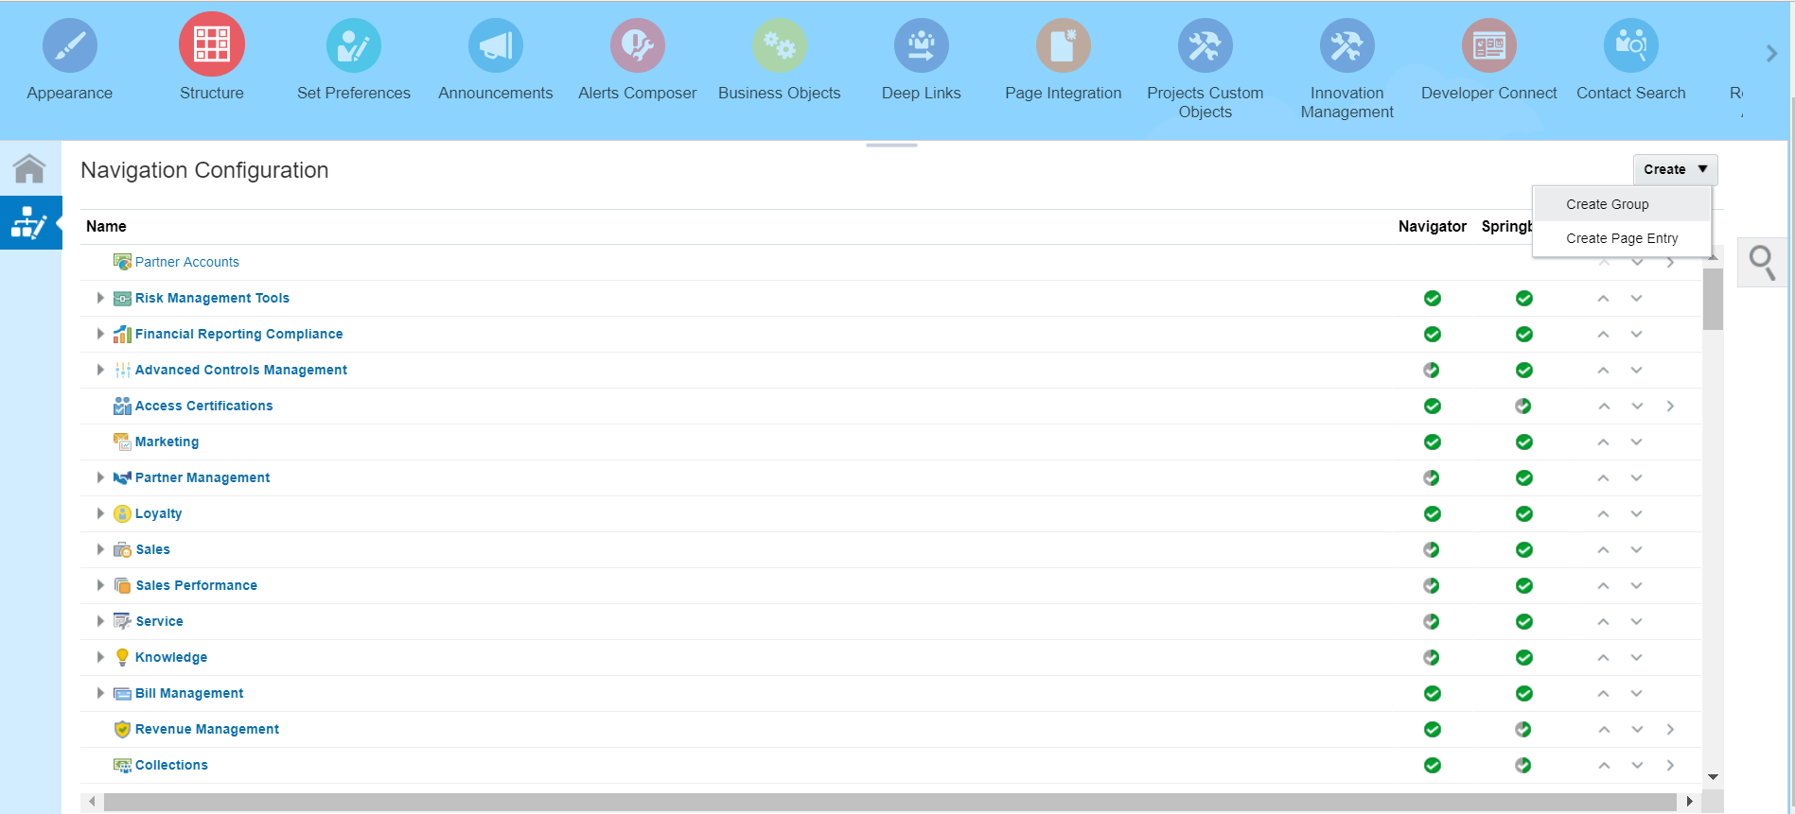
Adding the Webpage to navigator
Login to HCM Click on Navigator Click on structure Select Create page entry

Slide 14
Adding the Webpage to navigator (contd.)
Login to HCM Click on Navigator Click on structure Select Create page entry

Slide 15
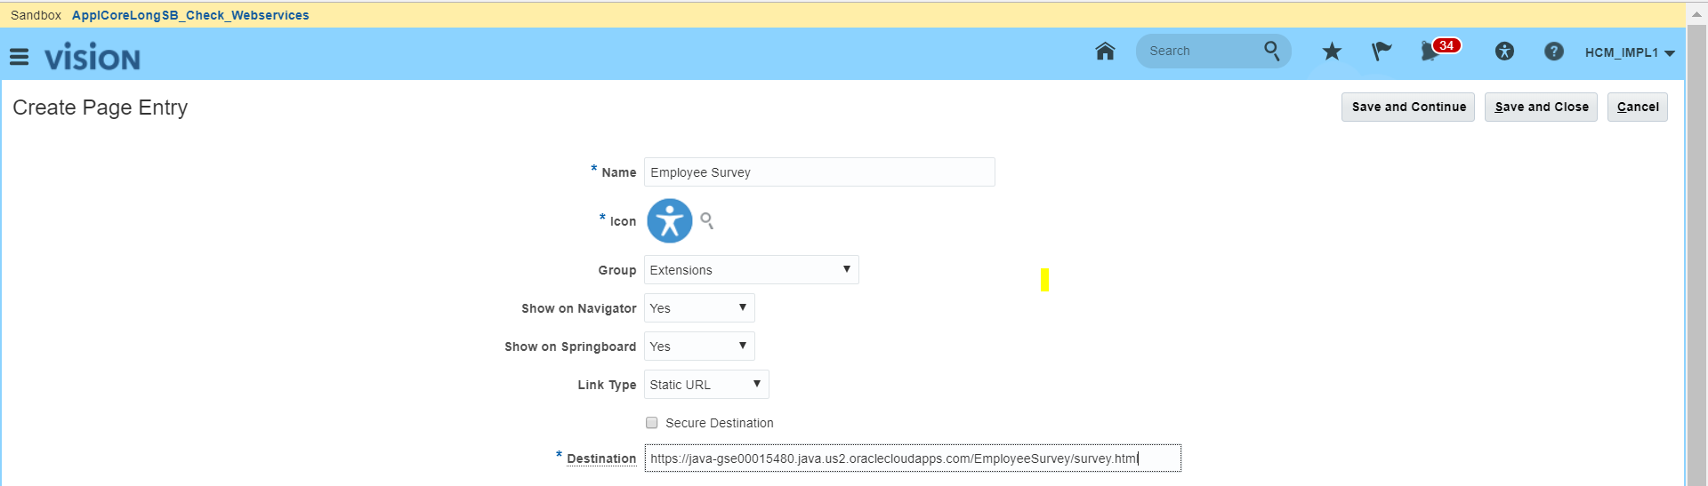
Adding the Webpage to navigator (contd.)
Provide the details of the web page, Click Save and close

Slide 16
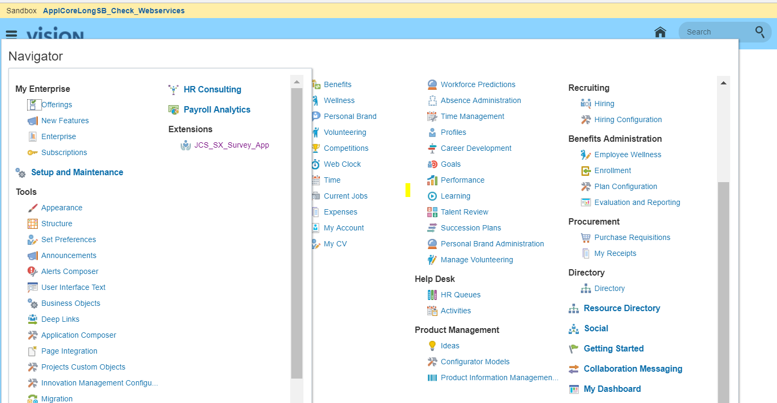
Adding the Webpage to navigator (contd.)
Verify the webpage in navigator and click on it to open

Slide 17
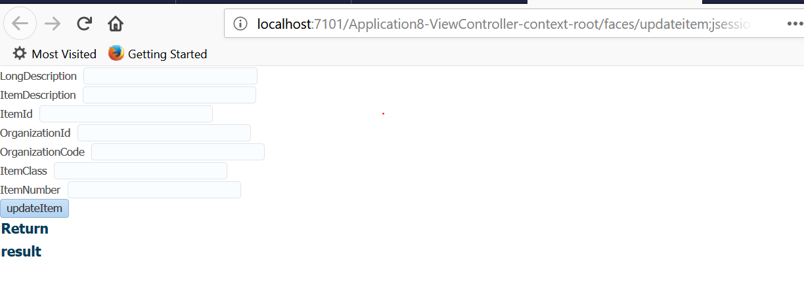
Opening The webpage

Slide 18
Adding webpage as a SubTab to an Object
Application Composer toolkit is used to complete this task. Activate a sandbox.
From the Oracle Sales Cloud Navigator menu, under the Tools category, click Application Composer.
Expand Objects and then also expand Standard Objects then click Pages. The panel on the right side refreshes to display the editing interface. Verify that the Simplified Pages tab is selected.
Under Details Page Layout, click Standard Layout and then in the toolbar above, click the Duplicate icon to create an editable copy of the layout.
Click the link to the copy you created for example, Default custom layout. The Default custom layout editing interface is displayed. You can see a set of icons stacked vertically on the left depicting the subtabs that currently appear on the Details Page Layout page for the selected object.
At the bottom of the icon stack, click Add.
Select the Web content option and then, in the upper-right corner, click Next. The Details Layout: Default Layout: Create Subtab features two sections: Basic Information : For subtab display details.
URL Definition: Has a Palette from where system values can be selected for use in Groovy scripts, as well as a Groovy scripting interface for constructing a valid URL.
For Basic Information, enter a Display Label.
(Optional) In the Description field, you can enter a brief description and also change the default display icon.
Below the URL Definition area in the Edit Script window, enter a well-formed Oracle Java Cloud Service application URL. You can use Groovy script to create a static or dynamic URL.
Click Next, Click Save and Close.
The interface refreshes to show all the subtabs that are associated with the object, including the subtab you just created.

Slide 19
Creating Applications
Activate a sandbox.
From your application home page, click the Navigator menu, and then click Setup and Maintenance.The Setup and Maintenance interface opens.
Expand the Tasks menu on the right. This menu is represented by a page icon.
Click Manage Custom Setup Content.
In the Topology Definition panel, click Manage Third Party Applications.
Under Search Results, expand the Actions drop-down menu and then click Create.
In the Application Name field under Basic Information, enter the application name.
Enter the Full URL. You must use the HTTPS protocol; HTTP will not work.
Specify the Partner Name. If a Partner Name is not applicable, you may use this field to include any other notations.
In the upper-right side of the interface, click Apply to see a parsed-out view of the various application URL components in the Server Details region in the lower part of the screen.
To create the third-party application, click Save and Close.

Slide 20
Enabling Single Sign-on
Oracle Fusion Applications Cloud Service can be extended in many ways. To enable PaaS-SaaS integration, you can use federated single sign-on (SSO) with, perhaps, some additional setup tasks, such as like user identity synchronization.
The following are the component groups that you federate:
Oracle Fusion Applications Cloud Service components: Each instance of Oracle Fusion Applications Cloud Service has a dedicated identity management stack.
Oracle PaaS services: Services such as Oracle Developer Cloud Service, Oracle Integration Cloud, Oracle Messaging Cloud Service, and Oracle Process Cloud Service are protected by Oracle Identity Cloud Service.
One instance of Oracle Fusion Applications Cloud Service can be federated with one instance of Oracle Identity Cloud Service.
You can also federate with an identity provider outside Oracle Cloud (for example, a third-party, on-premises identity provider).

Slide 21
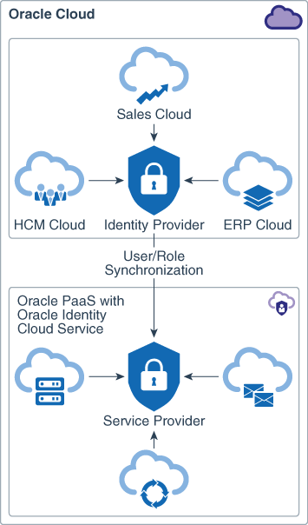
About Federated SSO Within Oracle Cloud
When all of the identity management systems that you want to federate are in Oracle Cloud, user identities can be maintained in either the identity management stack of Oracle Fusion Applications Cloud Service or in Oracle Identity Cloud Service.
When user identities are maintained in the identity management stack of Oracle Fusion Applications Cloud Service, that stack serves as the identity provider, and new users are created in Oracle Fusion Applications Cloud Service.
When Oracle Identity Cloud Service is the identity provider, the Oracle Fusion Applications Cloud Service identity management stack is the service provider. In this setup, you can create users in either the identity provider or the service provider.
Notes:
A major advantage of using Oracle PaaS for custom extensions is the highly secure connections that Oracle provides between Oracle PaaS and Oracle SaaS. For example, Oracle offers the SSO capability. Your users can authenticate once, and then they can use the PaaS-based extensions along with the SaaS services, without needing to sign in again, or maintain separate user accounts and passwords.

Slide 22
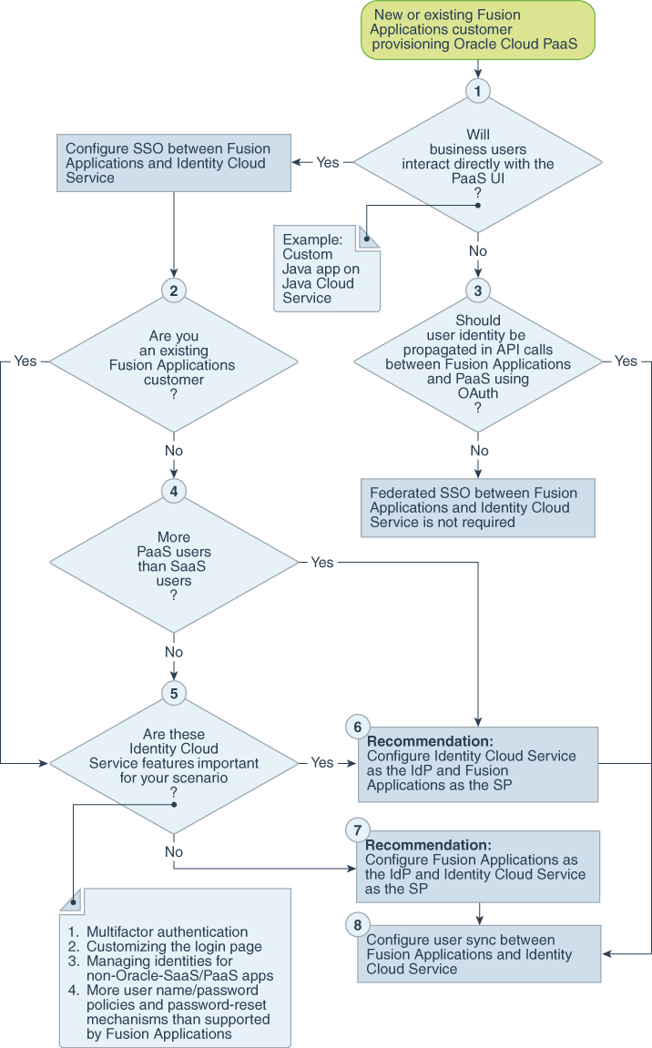
Tasks for Federating with Oracle Identity Cloud Service
Notes:
The tasks that you must perform to set up federated single sign-on (SSO) between Oracle Fusion Applications Cloud Service and Oracle Identity Cloud Service depend on whether you’re an existing or new Oracle Fusion Applications Cloud Service customer, whether you have relatively more users in Oracle Cloud PaaS or SaaS, whether you need identity propagation, and a few other factors.
User and role synchronization between Oracle Fusion Applications Cloud Service and Oracle PaaS is supported for all environments.
When using Oracle Fusion Applications Cloud Service as the identity provider, the setup requires an administrator to configure a synchronization job in Oracle Enterprise Scheduler. This job can create, update, and delete user identities, roles, and role assignments in Oracle PaaS. When Oracle Identity Cloud Service is a part of your environment, you also configure OAuth and endpoint applications in Oracle Identity Cloud Service. Synchronization of roles and role assignments starts from Oracle Fusion Applications Cloud Service even when Oracle Identity Cloud Service is the identity provider. In the most complex scenarios, you may need to configure the Oracle Enterprise Scheduler job to synchronize roles and role assignments, and configure an Oracle Identity Cloud Service application to synchronize user identities.

